Slide 1

KAKATIYA INSTITUTE OF TECHNOLOGY & SCIENCE,WARANGAL
(An AUTONOMOUS Institute under KAKATIYA UNIVERSITY – Warangal)
Opp:Yeragattu Gutta, Hasanparthy(M),Warangal,Telangana-506015 (INDIA)
DEPARTMENT OF ELECTRONICS & COMMUNICATION ENGINEERING
U18EC707 MAJOR PROJECT [AY 2024-25]
Title: PREDICTIVE MODEL OF TRAIN DELAYS IN A RAILWAY SYSTEM
Research Group:Machine Learning using python
BATCH NO:15
Team members:
  B21EC154 T.PRANATHI
  B21EC182 U.SANJANA
  B21EC145 G.SINDHUSRI
  B21EC176 T.RAMCHARANTEJ
Major Project Supervisor
SRI E.SURESH
Assoc Prof-Dept of ECE
Presentation no: 3
(Registration presentation)
Major Project Coordinator-8ECE3
Dr.R.Srikanth
Asst Prof-Dept of ECE
Major Project Convenor
A.Vijaya
Assoc Prof-Dept of ECE
Head of the Department
Dr.V.Venkateshwar Reddy
Assoc Prof-Dept of ECE

Slide 2
PRESENTATION CONTENT
OBJECTIVE AND EXPECTED OUTCOME
INTRODUCTION
EXISTING METHODS
DRAWBACK OF EXISTING METHODS
PROPOSED METHOD
DELAY PARAMETERS
ADVANTAGES
BLOCK DIAGRAM
RESULTS
APPLICATIONS
REQUIRED TOOLS
REFERENCES
TIMELINE

Slide 3
OBJECTIVE AND EXPECTED OUTCOMES
The main objective of our project is to develop a machine learning-powered web application that allows users to input train-related data and predict whether a train will be delayed.
The project uses a trained machine learning model and a flask-based web interface to make real-time predictions.

Slide 4
INTRODUCTION
Train delay is a significant problem that negatively impacts the railway industry and costs billions of dollors for each year.
In this project we have used Train delay dataset from IRTC to predict Train delays.

Slide 5
EXISTING METHODS
Traditional statistical machine learning methods consider train operation time features as model data to update algorithm structure and parameters in time such as delay prediction using Decision Tree Algorithm, SVM, LSTM Algorithms.
The actual delay data of the train should be updated in real time, But its Failed to Update on Real Time.

Slide 6
DRAWBACKS OF EXISTING METHODS
LSTM, SVM Algorithm cannot obtain precise results because of less features Considered.
SVM are prone to errors.
Some tree-based algorithms can require significant memory, especially when dealing with large datasets.
Each of these algorithms has it’s strengths, but these drawbacks highlight the challenges associated with their use in certain scenarios.

Slide 7
PROPOSED METHODS
Proposed Delay prediction is a process of estimating the probability of train delays at subsequent recording points based on train operation history data, and this is typically determined by arrival delays.
The train can be delayed due to various disturbances in the operation process.
Six parameters are selected after the analysis of the train arrival delays at the station to constitute the feature space (F).

Slide 8
DELAY PARAMETERS
Train Characteristic(X1)
Which day of the week it was (Monday,Tuesday etc.,one attribute for each)
Whether it was weekend(Saturday or Sunday),
Time of the day(one for morning/evening and one for day/night)
Weather attributes (temperature, snow depth, wind speed, visibility),
Train line the departure happened on (X0, X1, X3).

Slide 9
The training data was thereafter used to train the machine learning model to find connections between the inputs and train delays.
In the second stage of the machine learning process, the model was tested by using the testing data to determine its accuracy.
The chosen machine learning methods were Fast RCNN.

Slide 10
ADVANTAGES
Compared to SVM, the Fast R-CNN is more robust because it does have many Hidden Layers for better training Accuracy.
Thus, we expect to obtain more precise results on Delay relation identification
Can handle multiple input types that can be useful in predictive delay systems that need to process data from various sources.

Slide 11
BLOCK DIAGRAM
Input data
Preprocessing
Training dataset
Feature Extraction
Prediction regression
Testing Data
Delay Predict

Slide 12
IMPLEMENTATION
MODULES:
Data collection Module
Data preparation Module
Splitting the data Module
Training and Testing Module

Slide 13
1.IMPORTING LIBRARIES
Python from flask import Flask, request, jsonify, render_template, url_for
import pickle
from sklearn.preprocessing import LabelEncoder
from sklearn.model_selection
import train_test_split
import pandas as pd
2. Loading and Preprocessing the Dataset
3. Splitting the Dataset
4. Flask Application Setup
5. Defining Routes
6. Making Predictions
7. Returning the Result to the User
8. Running the Application

Slide 14
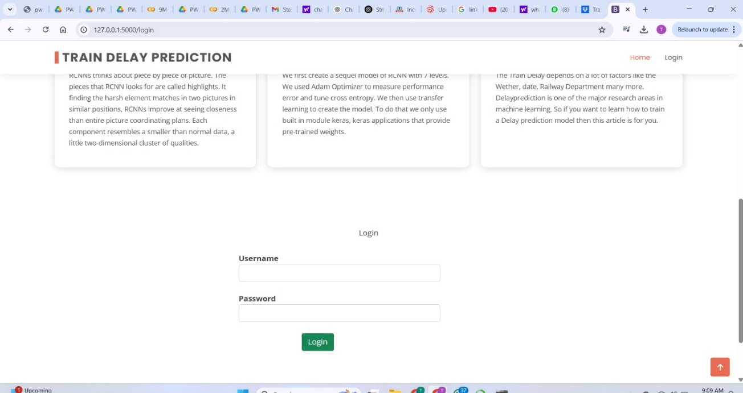
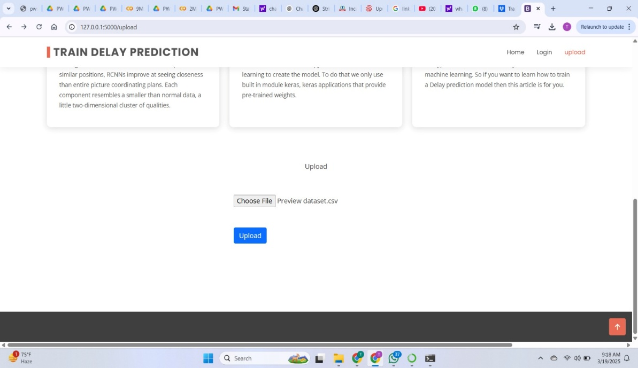
RESULTS

Slide 15
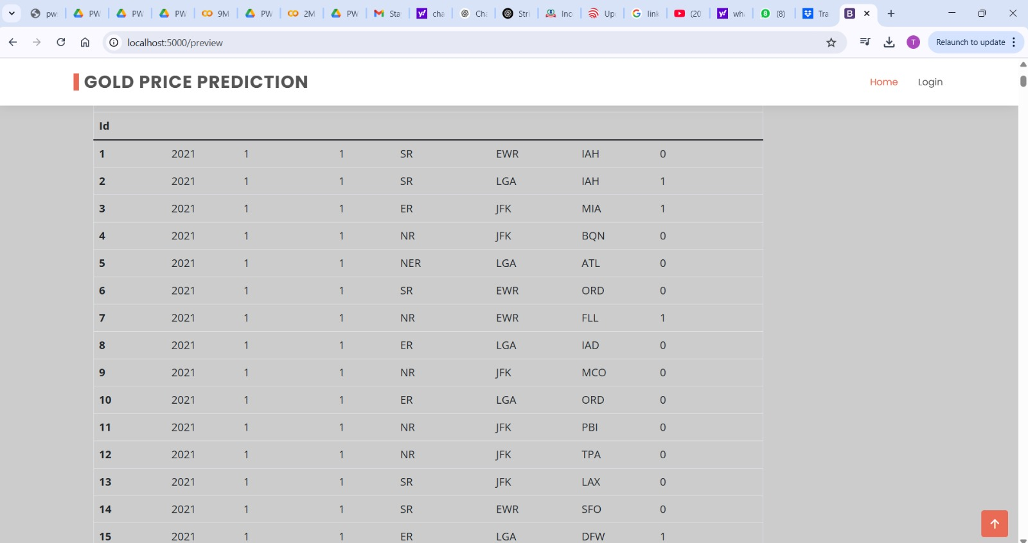
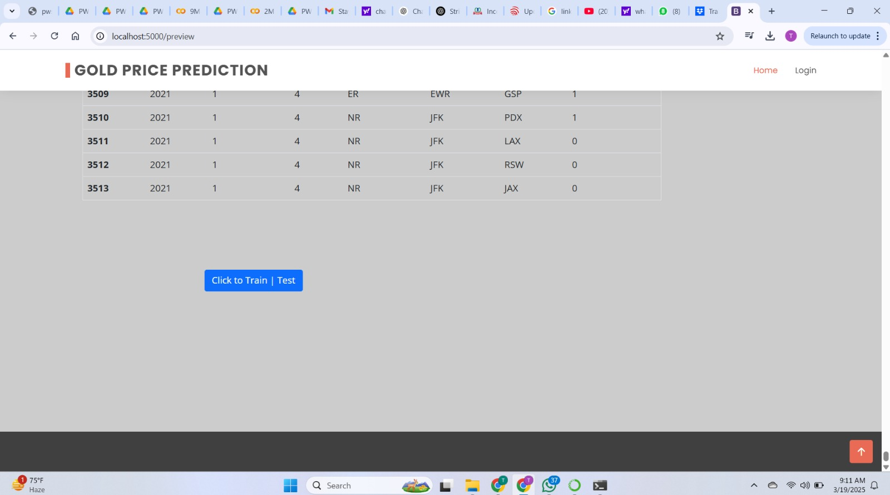

Slide 16
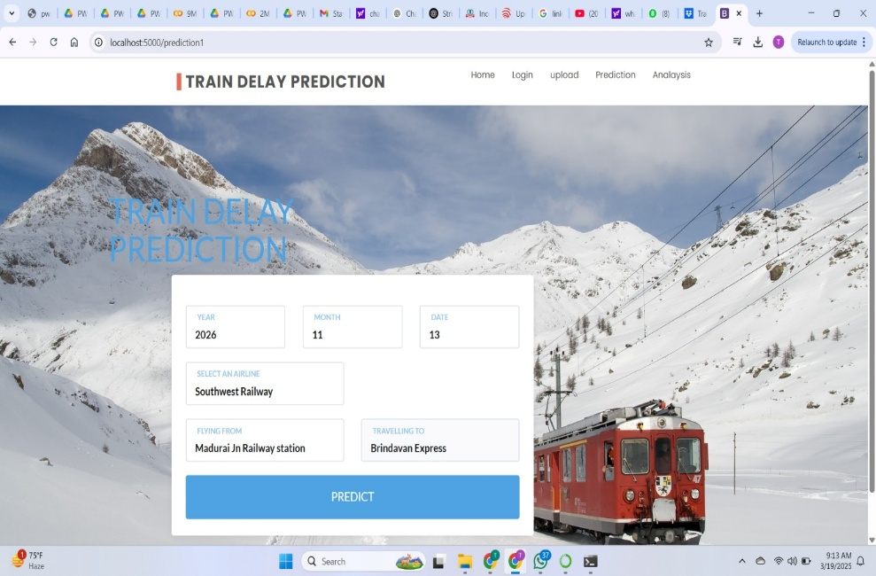
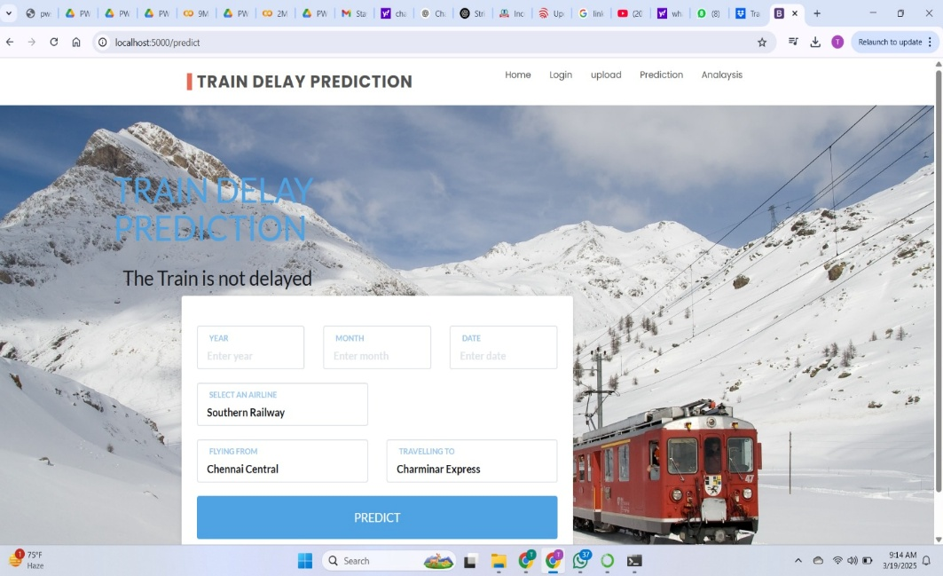
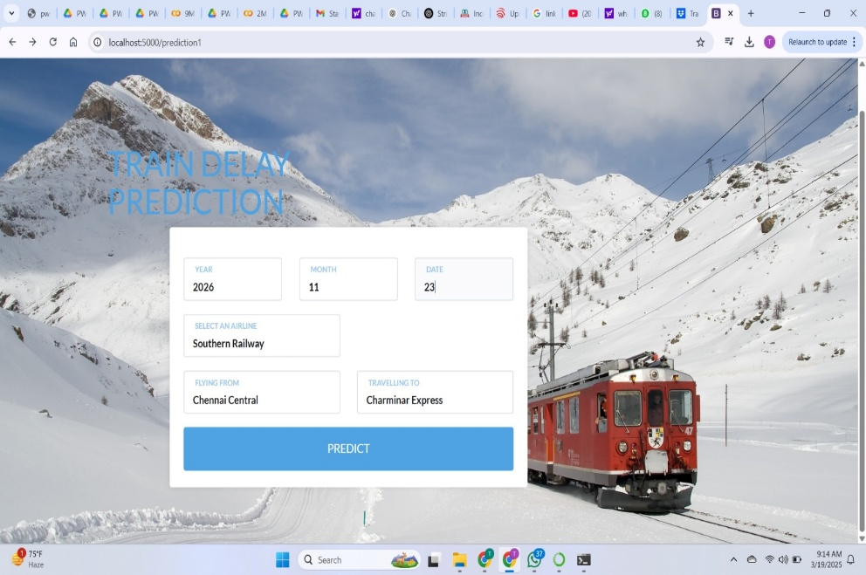
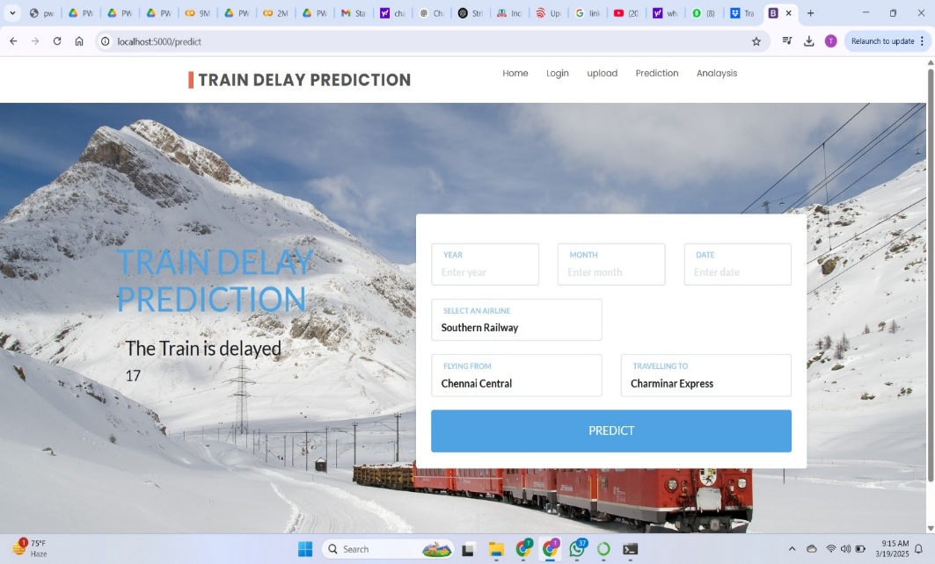

Slide 17
APPLICATIONS
Safety Improvement
Capacity Management
Schedule Optimization
Incident Management
Environmental Impact Reduction
Passenger Information Systems
Cost Reduction

Slide 18
REQUIREMENTS FOR PROJECT
Software Requirements:
Operating System : Windows
Front End : Anaconda Navigator
Database : CSV : Language : Python,HTML
Hardware Requirements:
Processor : I3 Above
Speed : 2.4 Ghz
RAM : 4 Gb (min)
Hard Disk : 500 Gb
Key Board : Standard Windows Keyboard
Mouse : Two or Three Button Mouse

Slide 19
REFERENCES
[1] Chao Wen et al. “A predictive model of train delays on a railway line” (2020)
[2] Panukorn Taleongpong et al. “Machine learning tech niques to predict reactionary delays and other asso ciated key performance indicators on British railway network”.
[3] Rahul Nair et al. “An ensemble prediction model for train delays”.
[4] Weiwei Mou , “Predictive Model of Train Delays in a Railway System”.
[5] Francesco, C.,Pavle, K.,2018.Stochastic prediction of train delays in real-time using Bayesian networks.

Slide 20
TIMELINE FOR THE PROJECT
S.NO. | ACTIVITY/MODULE/SUB-MODULE OF THE PROJECT | DURATION/DATE | STATUS
1 | Abstract Preparation | August’2024 | Completed
2 | Registration Seminar | August’2024 | Completed
3 | Data collection | September’2024 | Completed
4 | Data preparing | September’2024 | Completed
5 | (i)Progress Seminar - I (ii)Submission of Phase-I Project Report | October’2024 | Completed
6 | Major Project Work Phase – I – Viva-Voce | November’2024 | Completed
7 | Splitting the data module | December’2024 | Completed
8 | (i) Implementing using python code. (ii) Progress Seminar – II | January’2025 | Completed
9 | (i)Giving the inputs by running the main code and analysing the prediction | February’2025 | Completed
10 | Final Seminar Submission of Final Project Report | March’2025 | In progress
11 | Major Project Work Phase – II – Viva-Voce | April’2025 | In progress

Slide 21


